Slide 1
Topic 3.5 –Mole Concepts: Part 2
Unit 1

Slide 2
Vocab List
Empirical Formula
Molecular formula
Moles
Mass
Molar mass
Percentage

Slide 3
Learning goal
Topic 3.3 Mole Concept and Law of Conservation of Mass
Determine the percentage composition from relative atomic masses; empirical formula of a compound from the percentage composition by mass; and molecular formula of a compound from its empirical formula and molar mass.

Slide 4
Three quick questions
Determine the relative molecular mass of Nitrogen Dioxide (NO₂).
Determine the number of moles of Nitrogen Dioxide in a 37g sample.
Calculate the number of molecules in this sample.

Slide 5
brainstorm
What determines the formula of a molecule?
For covalent molecules , the number of electrons in its outer shell and how many electrons are needed to fill the outer shells for all atoms
For ionic molecules, the number of ions that are electrostatically attracted, to balance the overall charge

Slide 6
Two types of Formula of molecules
Molecular formula
Empirical formula
The actual number of each atom in a molecule
E.g.
Water H₂O
Carbon dioxide CO₂
Glucose C₆H₁₂O₆
Most commonly, we use the molecular formula
The ratio of different atoms in a molecule
E.g.
water H₂O
Carbon dioxide CO₂
Glucose CH₂O

Slide 7
Your turn
Classify these as either Empirical or Molecular Formula:
CH₂O
H₂SO₄
H₂O₂
HCl
Identify which of these molecules the formula could be both Empirical and Molecular

Slide 8
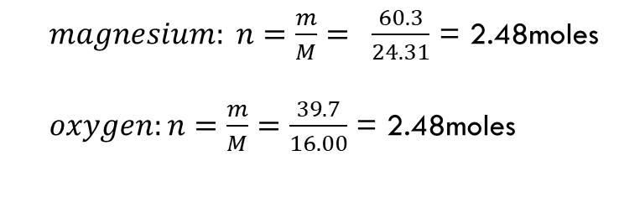
Determining empirical formula
From Percentage:
E.g. a compound contains 60.3% Magnesium and 39.7% Oxygen. Determine the empirical formula.
$magnesium: n=\frac{m}{M}= \frac{60.3}{24.31}$ = 2.48moles
$oxygen:n=\frac{m}{M}=\frac{39.7}{16.00}$ = 2.48moles
Molar mass Mg = 24.31
Molar mass O = 16.00
Assume mass of compound is 100g (because % is 100%)
Therefore,
Mg = 60.3g and O = 39.7g
Find the number of moles of each:
The ratio of Mg to O is:
2.48:2.48
1: 1
Therefore there is 1 Mg for each O
The empirical formula must be MgO

Slide 9
Your turn
A compound of Carbon and Oxygen contains 27.3% Carbon and 72.7% Oxygen by mass. Determine the empirical formula of the compound.
Notes:
2.28 mole C
4.54 mole O
CO2

Slide 10
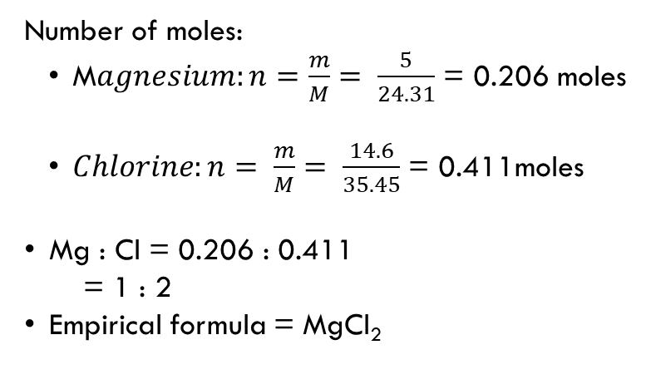
Determining empirical formula
From Mass
E.g. 5g of Magnesium is heated and allowed to react with 14.6g Chlorine gas. A white powder is formed. Determine the Empirical formula of the compound.
Number of moles:
M$agnesium:n=\frac{m}{M}= \frac{5}{24.31}$ = 0.206 moles
$Chlorine:n= \frac{m}{M}= \frac{14.6}{35.45}$ = 0.411moles
Mg : Cl = 0.206 : 0.411
= 1 : 2
Empirical formula = MgCl₂
Mass Mg = 5g
Molar Mass Mg = 24.3g/mole
Mass Chlorine = 14.6g
Molar Mass Cl = 35.45g/mole

Slide 11
Your turn
HINT: you will also need to calculate the mass of Oxygen. This would equal to the mass of the NO compound minus the mass of Nitrogen.
A 16.06g sample of Nitrogen reacts with Oxygen to form 62.00g of a compound containing only Nitrogen and Oxygen atoms. Determine the empirical formula of the compound.
Notes:
62-16 = 46g O2 = 2.875 mole O
16.06/14.00 = 1.147 moles N
2.875/1.147 = 2.5
N2O5

Slide 12
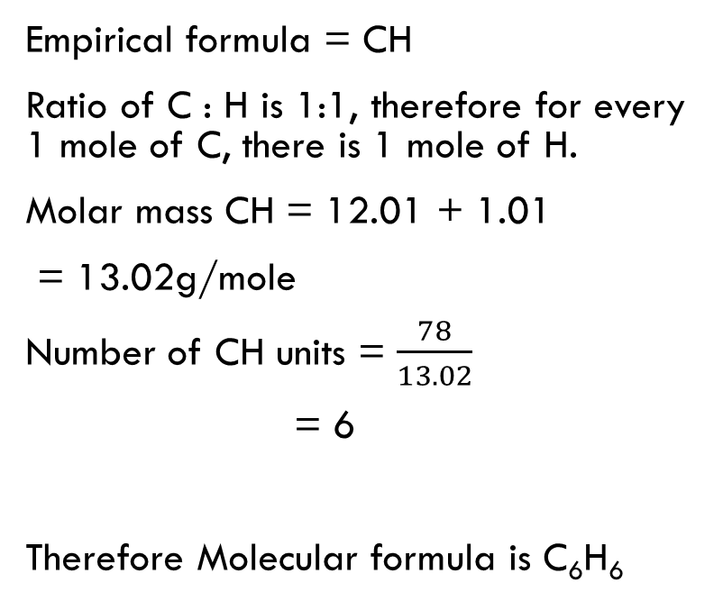
Determining Molecular formula
E.g. a compound has the empirical formula CH. The molar mass of this compound is 78g/mole. Determine the molecular formula of this compound.
Empirical formula = CH
Ratio of C : H is 1:1, therefore for every 1 mole of C, there is 1 mole of H.
Molar mass CH = 12.01 + 1.01
= 13.02g/mole
Number of CH units = $\frac{78}{13.02}$
= 6
Therefore Molecular formula is C₆H₆
We’re essentially asking how many of these CH units are needed to make up 78 g/mol
Notes:
C6H6

Slide 13
Your turn
A compound has an empirical formula C₂H₅. The molar mass of this compound was determined to be 58g/mol. Calculate the molecular formula of the compound.
Notes:
Molar mass of a C₂H₅ unit = (12.01x2) + (1.01x5) = 29.07
59/29.07 = 2. Molecular formula = C₄H₁₀

